Slide 1

FB-CPU DESIGN PROJECT
DOĞU ŞAHİN
AGAH ATAY ÖZBELLİ
ZEYNEP ÜRAZ
ONUR KART

Slide 2
AIM OF THE PROJECT DESIGN
Within the scope of this project, RTL design of a processor named FB-CPU with Verilog language and on the designed processor Various code snippets written in machine language will be written.
At the end of the project, it will be observed how the RAM, Control Unit and Storage Devices in a simple processor work together and Decode code snippets in machine language.
An FBCPU demo will be performed on the Basic FPGA development card to be used.
FB_CPU is an educational processor designed to explain the basic operating principles of processors.
The Von Neumann architecture is used in the processor

Slide 3
STRUCTURES THAT CONTAIN A FB-CPU
REGISTERS
MEMORY (RAM)
PROCESSING UNIT (ALU)
CONTROL UNIT

Slide 4
TOOLS TO BE USED WHEN DESIGNING THE PROCESSOR
Von Neumann Simulator
It is usefull in developing algorithms for the processor
AvionChip
used for RTL design

Slide 5
VON NEUMANN ARCHITECTURE
The von neumann architecture is the first and important computer design consisting of a processor and memory Decoupling the relationship between them.
Components
According to the Neumann design, a computer consists of the following units:
processor (processor)
memory (memory)
input-output unit

Slide 6
PROCESSOR UNIT
The processor or central processing unit (CPU) is responsible for running the instructions of the computer programit is an electronic (microprocessor) circuit.
The arithmetic and logic unit (ALU, Arithmetic Logic Unit) consists of three parts:
1) Recorders (registers, counters)
2) Control unit
3) ALU is the unit in which arithmetic operations such as addition/subtraction/division are performed, and logic operations such as/or/not.
Register elements are high-storage galisan storage areas located in the processor. The data is stored in these areas before processing.
The control unit ensures the coordination between the ALU and the input elements during the processing of the sequence of instructions (program) that it reads from memory.

Slide 7
MEMORY UNIT
According to the Von Neumann architecture, instructions (instructions) and the data used/generated in the program (data) are stored in main memory (RAM) during the operation of a program.
RAM can communicate directly with the CPU. The program itself is stored in the fixed/annual memory (mass storage) part, which is used as long-term storage.

Slide 8
There are 4 stashers in my plan.
status: In the status machine, information is kept about which status it has received.
PC: The operation information of the command at which address in RAM is stored.
IR: The command itself is running at that moment.
ACC: Temporary storage area

Slide 9
All other registers would operate based on the state register. In other words, the progress of the system depends on the status signal. The memory signals connected to the input and output ports in the design are given below.
• MAR (6 Bit): It is a register called Memory Address Register. This register is connected to the address input ofRAM. Since RAM has 2^6 locations, MAR is 6 bits. The register is in the inside of RAM.
• MDRIn (10 Bit): Memory Data Register In is the register used when data is written to RAM. Since one location of RAM is 10 bits, the register is 10 bits. The register is in the inside of RAM.
• RAMWr (1 Bit): It is activated when data will be written to RAM. If it is not 1, no data is written to RAM. The register is in the inside of RAM.
• MDROut (10 Bit): Memory Data Register is the register used when data is read from RAM. Since one location of RAM is 10 bits, the register is 10 bits. The register is in the inside of RAM.

Slide 10

CODE AND ALGORITHM PART

Slide 11
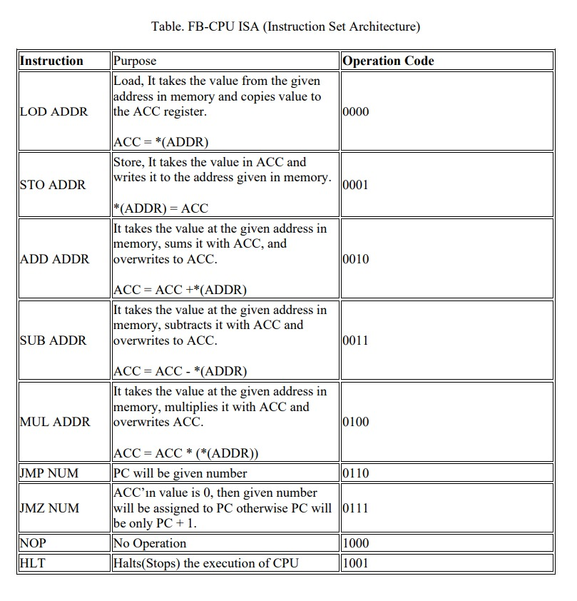
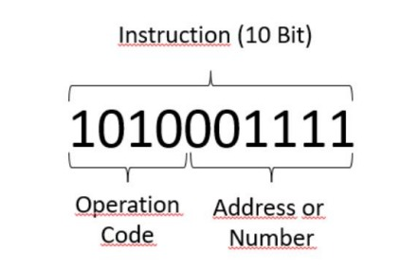

Slide 12
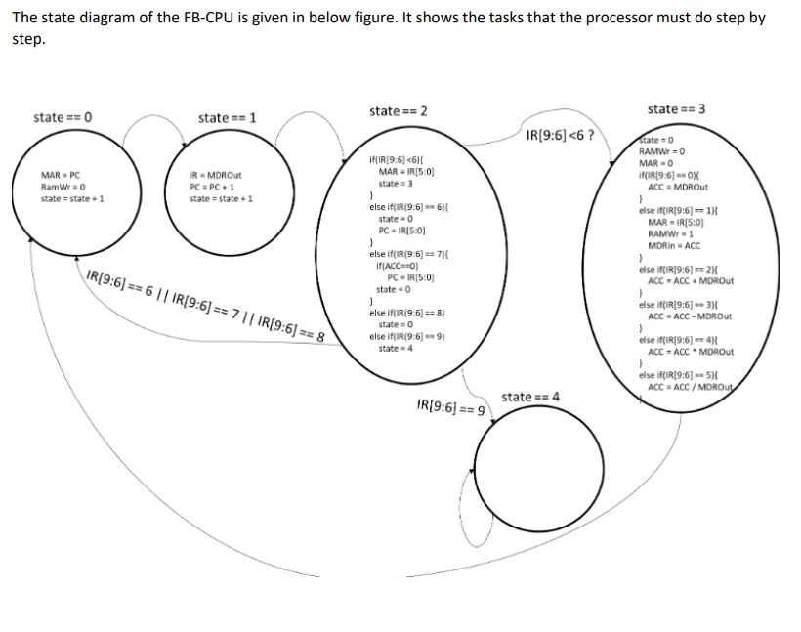

Slide 13
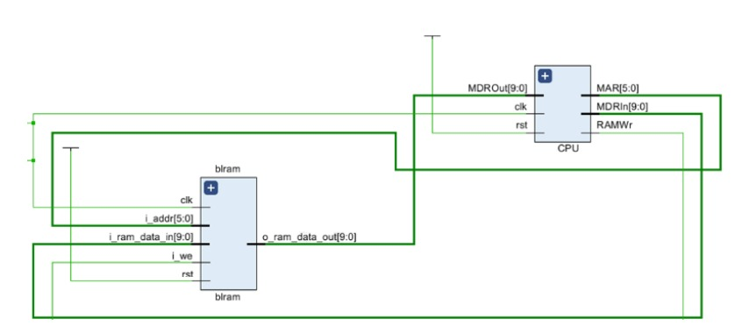

Slide 14
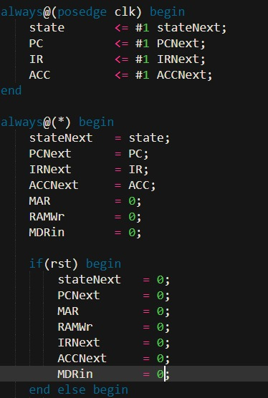
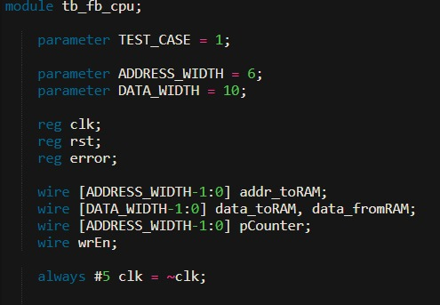
VERİLOG DESİGN STATES

Slide 15
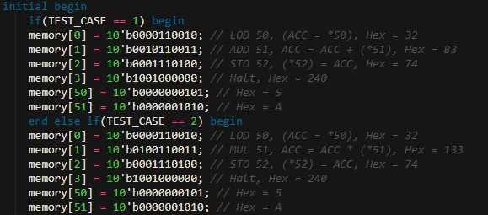
TEST CASE 1 AND 2

Slide 16
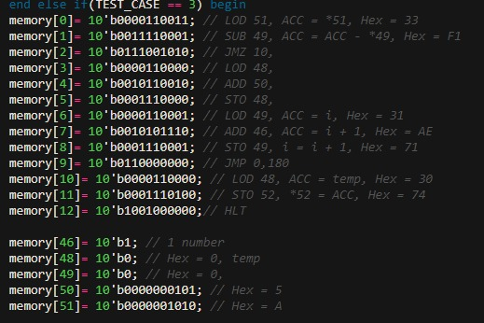
TEST CASE 3

Slide 17
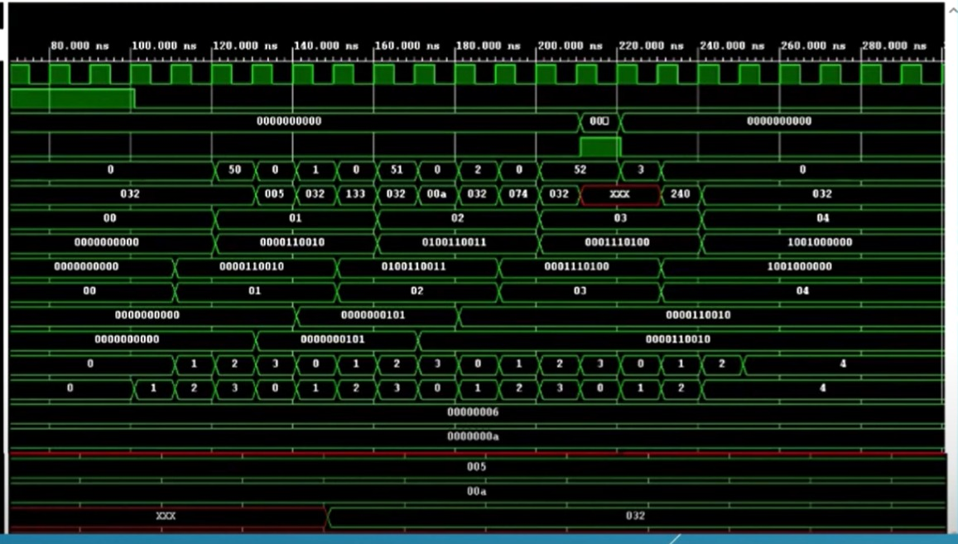
WAVEFORM OF THE CODE

Slide 18
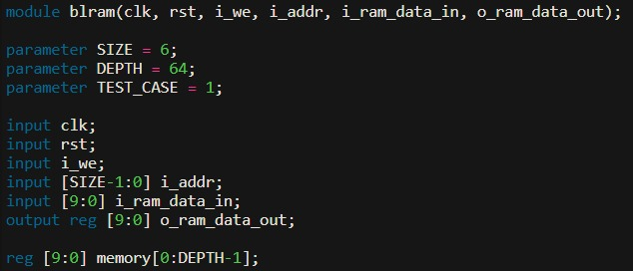

Slide 19
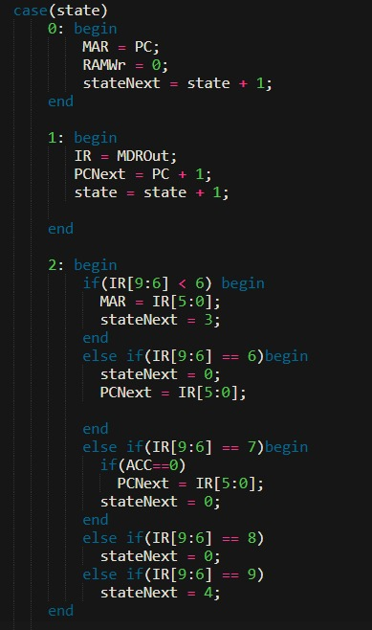
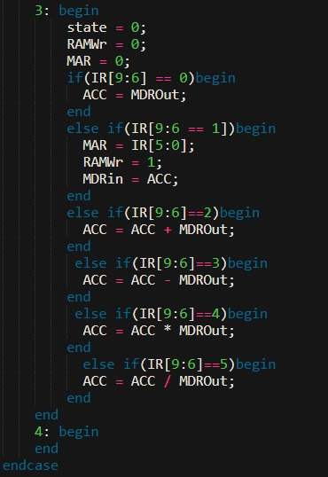
TESTBENCH PART INSIDE THE CPU

